Slide 1
Using Hop Teaming Data to Identify Referral Patterns
Mikil Taylor
VP of Analytics @ Healthcare Bluebook
Charles Lindquist
Manager of Market Analytics @ Healthcare Bluebook

Slide 2

AGENDA
Introduction & Background
Hop Teaming Dataset
NPIs and NPPES
Other Potentially Useful Datasets

Slide 3
Backgrounds
Mikil
Nashville Native
Recovering Actuary
At Healthcare Bluebook since 2012
Outside of work
Charles
Grew up in Atlanta
Avoided becoming an Actuary
At Healthcare Bluebook since 2014
Outside of work
Notes:
Outside work – farm, my house is more famous than I am (has its own Wikipedia page), writing a book, reading

Slide 4

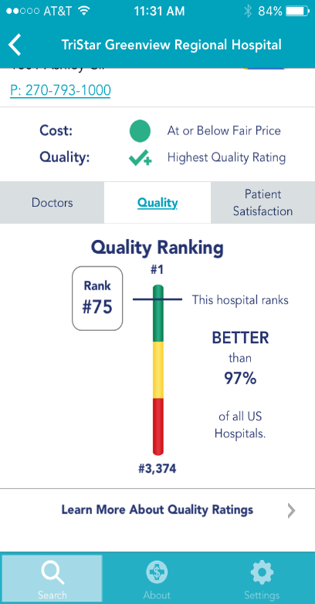
Healthcare Bluebook
Protect Patients by Exposing the Truth and Empowering Choice
Healthcare Price and Quality transparency
Download the free app!

Slide 5
Hop Teaming

Slide 6

Social Graph
Facebook, Twitter, LinkedIn, etc
Nodes and edges
Notes:
Social graphs

Slide 7
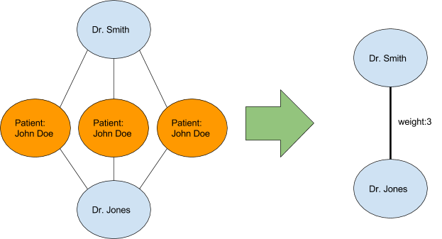
Hop Teaming
Social Graph for Healthcare
Nodes are Doctors and Facilities
Edges are shared patients
Notes:
Largest publicly available social graph
One difference is that our graph is actually directional

Slide 8
Directional Patient Flows
Edges are directional patient flows
These can be different depending on direction
More Twitter, less Facebook
Dr Smith
Jan 1
First Doctor | Second Doctor | Count
Dr Smith | Dr Jones | 1
Dr Jones | Dr Smith | 0
John Doe
Jan 5
Dr Jones
Notes:
Let’s go through some examples, and what the data will look like
Pause here – who has questions

Slide 9
Directional Patient Flows (cont.)
Additional visit
Jan 15
Dr Smith
First Doctor | Second Doctor | Count
Dr Smith | Dr Jones | 1
Dr Jones | Dr Smith | 1
John Doe
Jan 1
Jan 5
Dr Jones

Slide 10
Directional Patient Flows (cont.)
Add doctors
Dr Crane
First Doctor | Second Doctor | Count
Dr Smith | Dr Jones | 1
Dr Smith | Dr Crane | 1
Dr Jones | Dr Smith | 0
Dr Jones | Dr Crane | 1
Dr Crane | Dr Jones | 0
Dr Crane | Dr Smith | 0
Jan 15
Dr Smith
John Doe
Jan 1
Jan 5
Dr Jones
Notes:
One office visit (Crane) actually resulted in two implied referrals, from both Smith and Jones
Any questions on what causes this data?
Let’s talk about the data we actually have

Slide 11
Hop Teaming Data
IDs
from_npi
to_npi
Description
patient_count
transaction_count
average_day_wait
std_day_wait
Notes:
IDs and Descriptions

Slide 12
Tips
Lower patient counts generally reflect “unintentional” referrals
Highest patient counts frequently represent interactions with bulk providers
Labs, Hospitals, etc
Comparing specialties of both NPIs is a wonderful way to cut through noise
Orthopedists to Hospitals
All MDs to Radiology Centers
Where MDs order their labs
Some specialties are unlikely to refer out
Lab facilities may have little to no influence on where patient goes next
Notes:
Can’t just sort by count and assume that the highest numbers are your best data
How can you get to best data? Context!
Referrals from labs are probably accidents

Slide 13
Tips (cont.)
High average day wait generally reflects “unintentional” referrals
Low average day wait often reflects tightly integrated orgs
ER Physician and Hospital
Read the documentation

Slide 14
Caveats and Limitations
Derived from Medicare data
Consider who and what Medicare covers (and doesn’t cover)
CMS (Center for Medicare & Medicaid Services) Privacy Policy
Any relationship with fewer than 11 different patients is suppressed
Inferred referrals, not explicit
Notes:
Medicare doesn’t pay for many births, or pediatrician visits
Most importantly, this is inferred by data, NOT ACTUAL EXPLICIT REFERRALS. You have to use the data to figure out which ones were probably explicit
All we have in the hop teaming data is ID, so let’s connect that to some names and addresses

Slide 15
NPI & NPPES

Slide 16
What is an NPI
National Provider Identifier
10 digit unique number assigned to both individuals and organizations
Mandatory for all bills to Medicare
Freely available data set from CMS (Center for Medicare Services)
Best “key” value to use for most providers

Slide 17
Main NPI fields
Entity Type
1 = Provider (doctors, nurses, etc)
2 = Facility (Hospitals, Urgent Care, Doctor Offices)
Name
First/Last etc
Organization/Other Organization Name
Address
Business Practice Location (not mailing)
Taxonomy Code
Up to 15
Use Primary Switch = Y – not always in spot 1

Slide 18
Caveats and Limitations
Little to no QA or Validation
Zero incentive to keep accurate or up to date
Old addresses, retired doctors, incorrect specialties, home phones, etc
Little to no standardization
Provider Credential Text contains “MD” and “M.D.”
Physicians are required to have only one NPI
Some have an additional NPI for their office
Facilities can have multiple NPIs
Hospitals frequently do this
Facilities can use one NPI for multiple locations

Slide 19
Other Useful Datasets

Slide 20
Taxonomy Codes
ID for different specialties
Crosswalk to specialty name

Slide 21
Hospital Taxonomy Example
Notes:
Organization_Name like '%VANDERBILT%’
Business_Address_Line_1 like '1211 Medical Center Dr%'

Slide 22
Hospital Dupe NPI Example
In NPPES, there are 3 NPI results with below parameters (Trying to find NPI to use for TriStar Centennial Medical Center):
Taxonomy_1 = ‘282N00000X’ and Primary_Taxonomy_Switch_1 = ‘Y’
Business_Address_Line_1 = ‘2300 PATTERSON ST’
Notes:
‘282N00000X’ Taxonomy Code is for General Acute Care Hospital
The address for TriStar Centennial is 2300 Patterson St.
Postal Code is 37203
* Could combine NPIs and aggregate Hops. Just make sure to not only use NPI ‘1932146032’ or ‘1841237948’.

Slide 23
CBSA Codes
Core-Based Statistical Area
Groups zip codes into a Micropolitan/Metropolitan area
34980 is the CBSA for greater Nashville metro
~150 zip codes make up Nashville CBSA
Notes:
Can help with identifying greater Nashville area hospitals
Nashville CBSA includes Nashville, Murfreesboro
Will be used for Neo4j project to identify communities of providers (Michael Holloway will go into detail on this)

Slide 24
Data.cms.gov
Go exploring!

Slide 25
Goal
Build referral profile of professionals referring to Nashville area Hospitals
Identify which professionals Vanderbilt should approach to bring in more volume
Competitor hospital referrals
Orthopedic and Family Medicine specialties
Use Neo4j to identify communities of providers in Nashville CBSA
Notes:
Filter from_npi to be entity type 1 and to_npi to be entity type 2.
We want to eliminate "accidental" referrals, so filter the hop teaming data so that the transaction_count is at least 50 and the average_day_wait is less than 50.
Competitor hospital referrals – target professionals that are sending significant volume to say TriStar Centennial Medical Center and NOT Vanderbilt already.
Orthopedic and Family Medicine specialties – if Vanderbilt wants to specifically increase referral volume from Orthopedic Surgery and Family Medicine doctors, who should they reach out to?

Slide 26
?
QUESTIONS

Slide 27
Appendix

Slide 28
Documentation
Hop Teaming (in order of relevance)
https://careset.com/datasets/hop-teaming/
https://careset.com/docgraph-hop-teaming/
https://careset.com/rootnpigraph/
NPPES
https://www.cms.gov/Regulations-and-Guidance/Administrative-Simplification/NationalProvIdentStand/Downloads/Data_Dissemination_File-Readme.pdf
Taxonomy Code
https://www.cms.gov/Medicare/Provider-Enrollment-and-Certification/MedicareProviderSupEnroll/Taxonomy

Slide 29
Data
DocGraph Hop Teaming
https://careset.com/datasets/
NPPES
http://download.cms.gov/nppes/NPI_Files.html
Taxonomy
https://data.cms.gov/Medicare-Enrollment/CROSSWALK-MEDICARE-PROVIDER-SUPPLIER-to-HEALTHCARE/j75i-rw8y
CBSAs
https://www.huduser.gov/portal/datasets/usps_crosswalk.html
Other
Data.CMS.gov

